Slide 1
Using the Qualifying Child/Relative Charts
Updated for 2017 and 2018 Tax Law Changes
Notes:
Instructor: there are 5 examples
The first should be used for new volunteers to introduce the tri-fold tool
Examples 2 and 3 can be used as hands-on practice with the you providing answers to the questions
Examples 4 and 5 present comprehensive concepts that may not be seen very often – these are for experienced and master counselors
Release 2: no changes

Slide 2
Tri-fold Purpose
An easy tool for a
clear, comprehensive
answer

Slide 3
Why not just dependency rules?
If we interview taxpayers with just the dependency rules in front of us,
And a family or household member isn’t a dependent,
We may forget to include him or her on the tax return...
...even when he should be included as a non-dependent for EIC or other benefits

Slide 4
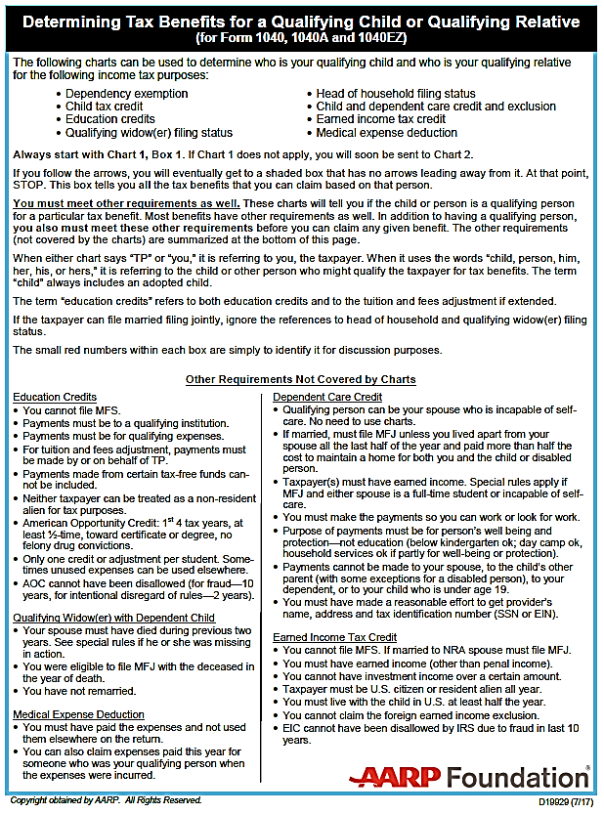
Laminated Tri-Fold
Every Tax-Aide Counselor should have the 2018 laminated tool (or 2017 with updates) at their side during training and at their site
Notes:
How many use a chart for single or MFJ?

Slide 5
Qualifying Child / Relative Tri-Fold Tool
Simplifies
Determining Filing Status
Identifying qualifying persons
Eliminate mistakes that otherwise might never be caught or corrected

Slide 6
How to use them: Read the Introductory Page
Notes:
Covers eight tax benefits. Does not cover student loans.
Charts tell if you have a qualifying child, but there are also OTHER REQUIREMENTS.
Taxpayer is referred to as “you.” Child or other person is referred to as “him” or “her.”

Slide 7
Terms You Need to Know (back of laminated tri-fold)
Custodial and noncustodial parent
Eligible foster child
Full-time student
Gross income
Incapable of self-care
Permanently and totally disabled
Relationships not terminated by divorce or death
Resident alien
School defined
Any other taxpayer
Temporary absence
Tie-breaker Rules
U.S. national

Slide 8
Start with Qualifying Child Chart 1
Use one taxpayer (or a taxpayer couple if filing MFJ) – referred to as “you”
And one child or other person – referred to as “him” or “her”
Use the child’s name when asking the questions
Notes:
If taxpayer is filing MFJ, questions refer to either the taxpayer or spouse

Slide 9
Use the Child’s Name
If the child’s name is Joe, start at Box 1 and ask, “Was Joe a U.S. citizen, national or resident alien or a resident of Mexico or Canada during the tax year?”

Slide 10
Follow the Arrows
If the answer to the question in Box 1 is “yes,” follow the yes arrow to Box 3

Slide 11
Ask the Question in Box 3
Ask, “Was Joe your son, daughter, stepchild, eligible foster child, brother, sister, half-brother, half-sister, stepbrother, stepsister, or a descendant of any of them?”

Slide 12
Follow the Arrows
If the answer to the question in Box 3 is “yes,” follow the Yes arrow to Box 5
And ask the question in Box 5

Slide 13
Blue Boxes
When you get to a blue box, STOP
The blue box lists ALL the benefits for which this child qualifies the taxpayer
Read the whole box — important information is included in parentheses after most benefits
Read any footnotes that apply — they are critical

Slide 14
Repeat for Other “Children”
If there is an additional child (or household or family member) whose situation is different
You may get to a different blue box

Slide 15
Start with the Middle Generation
If the household has multiple generations, don’t start with the grandchildren, start with the children
You’ll need to determine if they ARE dependents before you can determine if they HAVE dependents

Slide 16
Start with Qualifying Child Chart
Even if you are analyzing a person who is not a qualifying child, start with the Qualifying Child Chart (Chart 1)
You will be directed to the Qualifying Relative Chart (Chart 2) if appropriate
It is easy to mistake the child of a non-custodial parent as a qualifying relative

Slide 17
It looks very complicated, but...
If your child’s situation is straight- forward, the chart will take you straight down the left-hand side to Box 29
These are the same 10 questions you would answer from Page C-3 of the Resource Guide (Pub 4012)

Slide 18
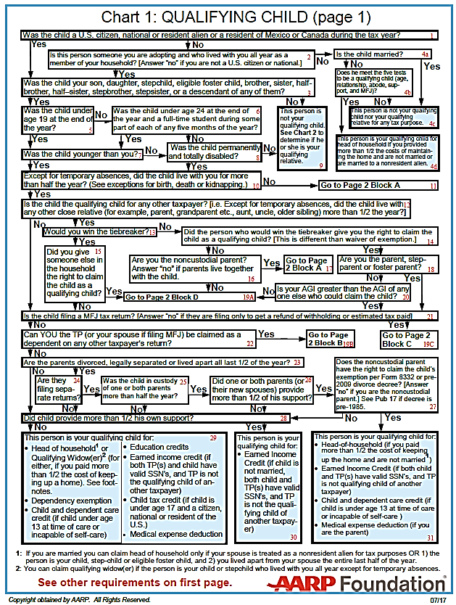
Citizenship?
Relationship?
Age?
Younger than you?
Residency?
Child of more than one taxpayer?
Child filing MFJ?
Can you be claimed as a dependent?
Parent separated and filing separate returns?
Did the child provide more than ½ of his own support?
Then, person is qualifying
child for all possible benefits

Slide 19
If Situation is Not Straight-forward
Follow the arrows and you will arrive at the correct answer

Slide 20
Example 1: John
Child (John) is self-supporting (because he receives social security survivor benefits used for his support)
Can he be claimed by his widowed mother with whom he lives?

Slide 21
Ex. 1: Start with John as QC of His Mother
Box 1, ask: Was John a US citizen, national or a resident alien or a resident of Mexico or Canada for some part of the tax year?
Yes – go to box 3

Slide 22
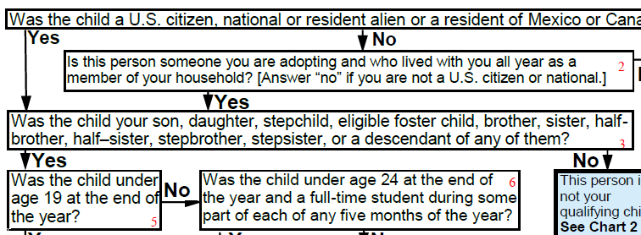
Ex. 1: John as QC of His Mother
Box 3
Box 3, ask: Was John your son, daughter, stepchild, eligible foster child, brother, sister, half-brother, half-sister, stepbrother, stepsister, or a descendant of any of them?
Yes, go to box 5

Slide 23
Ex.1: John as QC of His Mother
Box 5, ask: Was John under age 19 at the end of the year?
Yes, go to box 7
Box 7, ask: Was John younger than you? (“you” = Mother)
Yes, go to box 10

Slide 24
Ex.1: John as QC of His Mother
Box 10 ask: Except for temporary absences, did John live with you for more than half the year? (See exceptions for birth, death or kidnapping.)
Yes, go to box 12

Slide 25
Ex.1: John as QC of His Mother
Box 12, ask: Is John the qualifying child for any other taxpayer? [i.e. Except for temporary absences, did John live with any other close relative (for example, parent, grandparent etc., aunt, uncle, older sibling) more than ½ the year?]
No, go to box 21

Slide 26
Ex. 1: John as QC of His Mother
Box 21, ask: Is John filing a MFJ tax return? [Answer “no” if filing only to get a refund of withholding or estimated tax paid.]
No, go to box 22
Box 22, ask: Can you the TP (or your spouse if filing MFJ) be claimed as a dependent on any other taxpayer’s return?
No, go to box 23

Slide 27
Ex. 1: John as QC of His Mother
Box 23, ask: Are John’s parents divorced, legally separated or lived apart all last ½ of the year? (John’s dad is deceased)
No, go to box 28

Slide 28
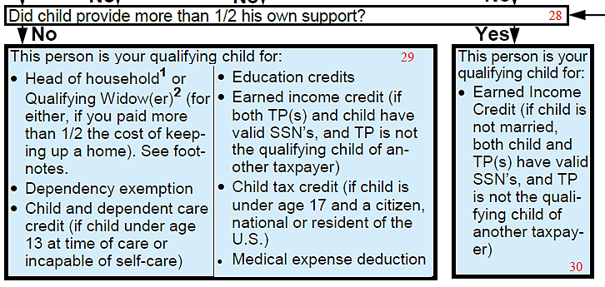
Ex. 1: John as QC of His Mother
Box 28, ask: Did John provide more than ½ his own support?
Yes, go to box 30

Slide 29
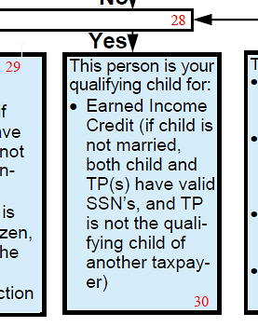
Ex. 1: John as QC of His Mother
Box 30: STOP – Blue box!
John is your qualifying child for earned income credit IF
He is not married,
Both you and he have valid SSNs, and
You are not the qualifying child of another taxpayer
But note:
No head of household
No dependency exemption
No child tax credit, etc.

Slide 30
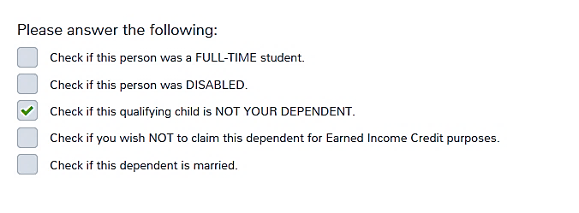
Ex. 1: Enter John in the Dependents Section
Not a dependent, but yes for EIC

Slide 31
Example 2: Al and Ann
The taxpayer, Al, paid for more than half of his live-in girl friend’s (Ann) support, including medical expenses
We know Ann is NOT Al’s dependent because her gross income is too high
But, can he claim medical and care expenses?
Class – use your tri-fold tool to ask questions

Slide 32
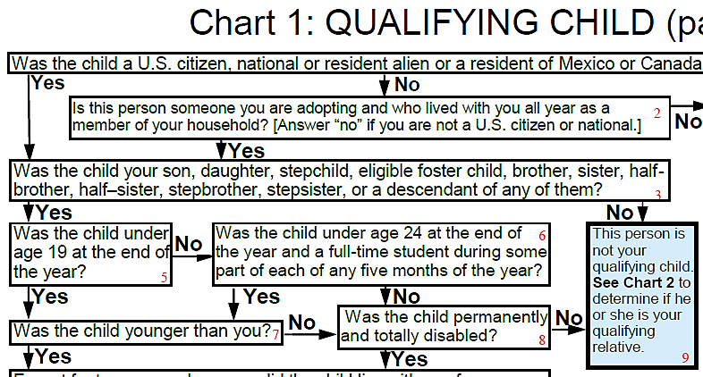
Ex. 2: Start with Ann as QC of Al
Box 1: Yes, Ann is a U.S. citizen
Box 3: No, no relationship
Box 9: Go to Chart 2

Slide 33
Ex. 2: Ann as QR of Al
Box 3: No, Ann is not Al’s qualifying child nor the qualifying child of any other taxpayer
Box 4: No, no relationship
Box 5: Yes, lived together all year (not against the law)
Box 8: Yes, Al provided more than ½ of Ann’s support

Slide 34
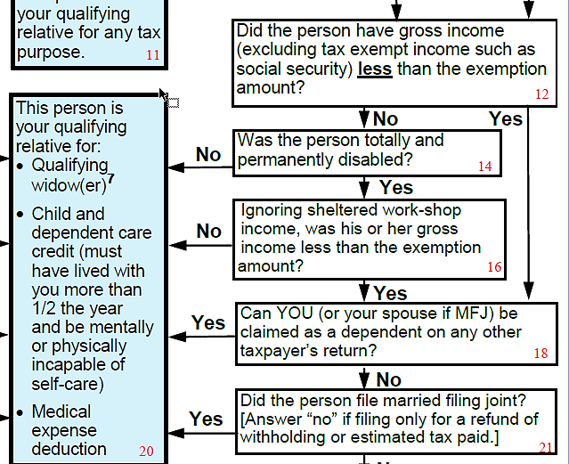
Ex. 2: Continue with Chart 2 (Ann as QR of Al)
Box 12: No, Ann’s income is not less than the exemption amount (it’s more)
Box 14: No, Ann is not disabled
Box 20 Blue Box!: Care expenses) if incapable of self care) and medical expenses

Slide 35
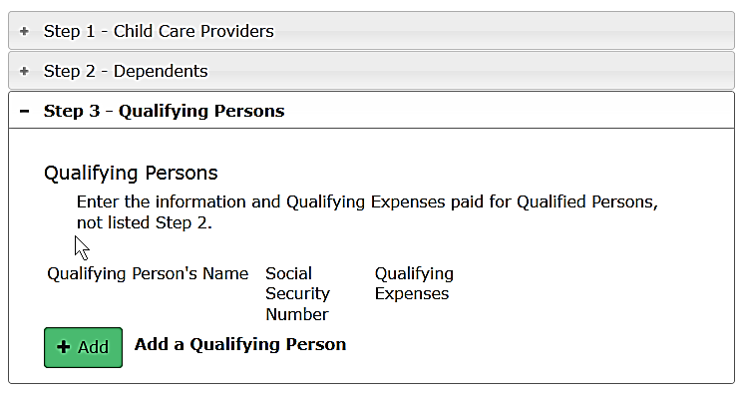
Ex. 2: Al and Ann Input
If Al paid qualified dependent care expenses for Ann because she was incapable of self-care, add Ann as a Qualifying Person (Form 2441 or credits menu)

Slide 36
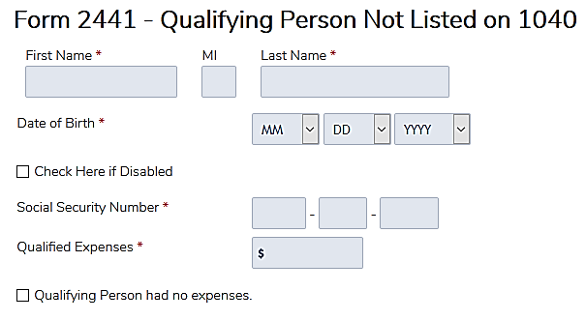
Ex. 2: Input Ann for Form 2441
TaxSlayer uses “Disabled” instead of “incapable of self-care”

Slide 37
Ex. 2: Input medical expenses
If Al paid Ann’s qualified medical expenses—enter as itemized deduction:

Slide 38
Example 3: Tom and Billy
Taxpayer (Tom) pays child support and pays for medical insurance for his child (Billy), but his ex-wife won’t sign Form 8332
Class: use your tri-fold tool

Slide 39
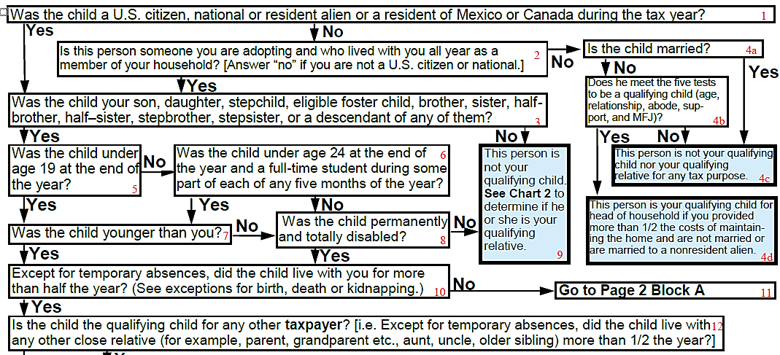
Ex. 3: Start with Billy as QC of Tom
Box 1: Yes, Billy is a US citizen
Box 3: Yes, Billy is Tom’s son
Box 5: Yes, less than 19
Box 7: Yes, younger than Tom
Box 10: No, did not live with Tom
Box 11: Go to Block A

Slide 40
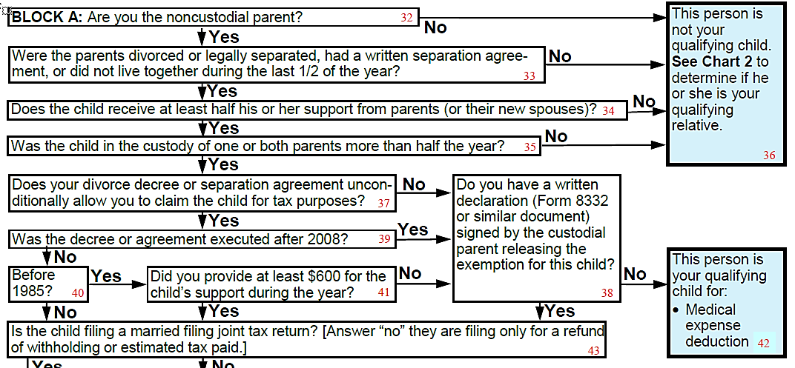
Ex. 3: Continue in Block A
Box 32: Yes, Billy is the noncustodial parent
Box 33: Yes, divorced
Box 34: Yes, supported by Tom
Box 35: Yes, ex has custody
Box 37: No, Tom cannot claim Billy
Box 38: No, Tom doesn’t have 8332
Box 42 Blue Box!: Tom can claim Billy’s medical expense

Slide 41
Ex. 3: Claim Billy’s Medical
Tom can claim Billy’s medical on Sch A

Slide 42
Other Requirements
Charts tell you if there is a qualifying person for a given tax benefit
Most tax benefits have other requirements that must be satisfied
These are summarized on page 1 of the tri-fold tool

Slide 43
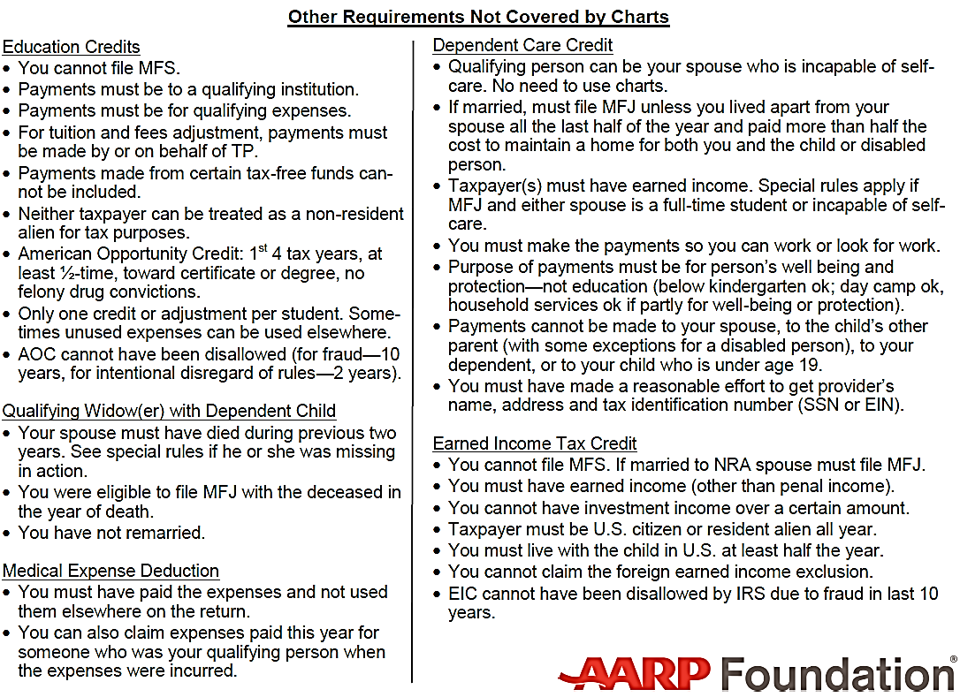
Summary – See Pub 17 for details
Neither taxpayer can be treated as non-resident alien for tax purposes.
Payments must be so you can work or look for work.
You have not remarried.
You cannot file MFS.
Notes:
These are important...and sometimes forgotten

Slide 44
Limitations
You need to know the definitions – many are on the back of the tri-fold tool
Must not forget to check the other requirements
Chart doesn’t cover student loan interest

Slide 45
Example 4: Alex and Sara
Alex (age 28) and his wife, Sara (age 25), were in a bad car accident in February
They got out of the hospital in April and went to live with Alex’s parents rent-free while they recovered
Prior to the accident, Alex and Sara had earned $5,000 each
After more than a year, both are still unable to work due to their injuries
Can Alex’s parents claim Alex and/or Sara?
Notes:
Example 4 is for experienced students

Slide 46
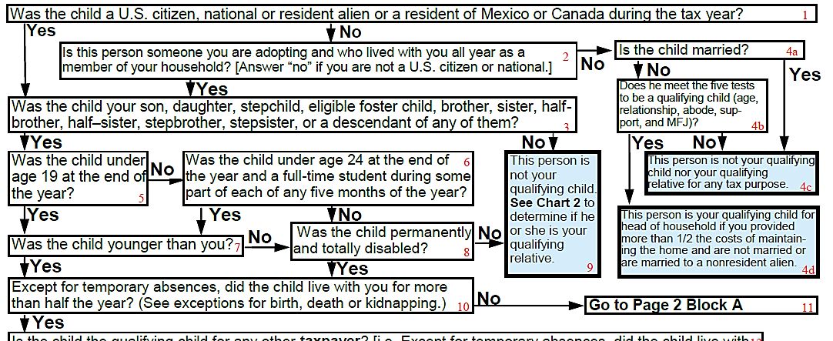
Ex. 4: Start with Alex as QC of his Parents
Box 1: Yes, Alex a US citizen
Box 3: Yes, Alex is their son
Box 5: No, Alex is over 19
Box 6: No, Alex is over 24
Box 8: See definition of permanently and totally disabled on back of trifold tool - unable to work for at least a year. It’s already been more than a year, YES, Alex is disabled
Box 10: Yes, Alex lived with his parents for 8 months
Notes:
Refer students to definitions on back of trifold tool

Slide 47
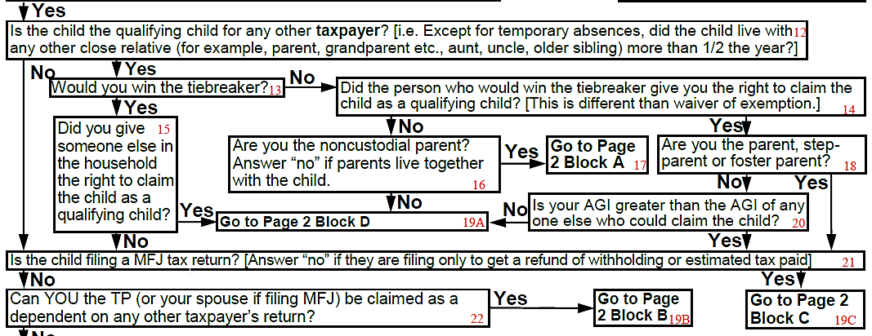
Ex. 4: Alex as QC of his Parents
Box 12: No, Alex is not the qualifying child for any other taxpayer
Box 21: Alex and Sara have no filing requirement and are filing just to get a refund of withholding, so let’s say “No” (if they claim EIC, we’d say “yes”)
Box 22: No, Alex’s parents cannot be claimed by another taxpayer
Notes:
Class can look up the potential EIC for Alex and Sara if they were to file an MFJ return (for 2016, it was $506)
If Alex’s parents would get more tax benefit than that, it makes more sense for Alex and Sara to not claim the EIC

Slide 48
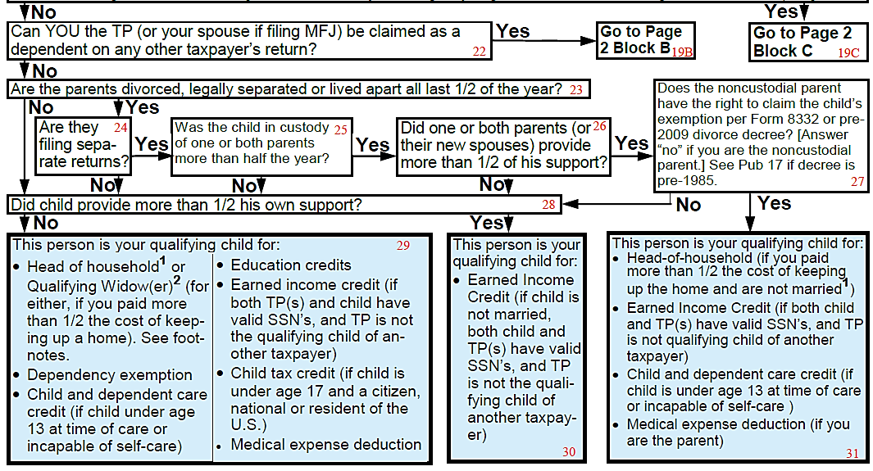
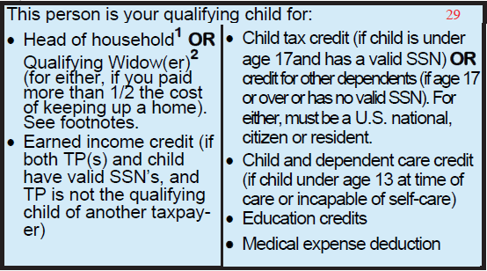
Ex. 4: Alex as QC of his Parents
Box 23: No, Alex’s parents are not divorced
Box 28: No, Alex’s parents can use the value of housing plus all other support costs they pay, so Alex did not provide more than ½ of his total support
Box 29: Blue Box!
Include Alex in dependents section of parents’ return

Slide 49
Ex. 4: Sara as QC of Alex’s Parents
Box 1: Yes, Sara a US citizen
Box 3: No, daughter-in-law is not one of the listed relationships
Box 9: Go to Chart 2

Slide 50
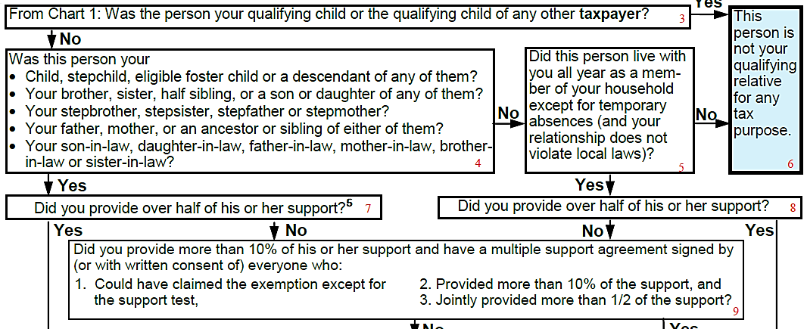
Ex. 4: Sara as QR of Alex’s Parents
Box 3: No, Sara is not a qualifying child of any other taxpayer
Box 4: Yes, Sara is their daughter-in-law
Box 7: Yes, Alex’s parents provided over half of Sara’s support

Slide 51
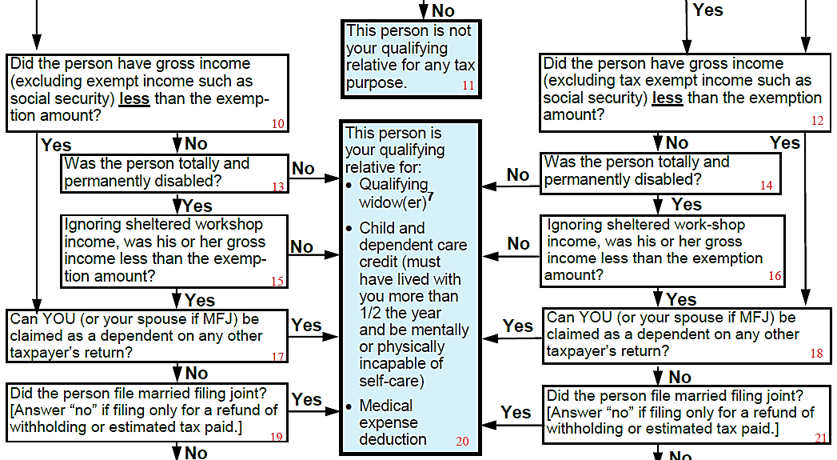
Ex. 4: Sara as QR of Alex’s parents
Box 10: No, Sara had gross income more than the exemption amount
Box 13: Yes, Sara is disabled
Box 14: No, Sara’s non-sheltered workshop income is more than the exemption amount
Box 20 Blue Box!
Alex’s parents deduct medical on Sch A and complete Form 2441 (dependent care credit) for qualified expenses they paid for Sara
Notes:
We said Sara made $5,000 before the accident. Suppose it had been less than the exemption amount?
Answer: Sara would be a QR of Alex’s parents

Slide 52
Ex. 4: Summary
Alex is a qualifying child for his parents for all tax benefits, including EIC since Alex is disabled
Alex’s parents cannot claim Sara as their dependent
If Alex’s parents paid any medical expenses or qualified care expenses for Sara, they could deduct the medical expenses and claim the dependent care credit
Alex and Sara can file to get a refund of tax withheld

Slide 53
Example 5: Lele
Mary and her baby, Lele, live with Mary’s parents while Mary continues with high school
Support agreement requires baby’s father (Sam) to pay $200/month in child support and allows him to claim the child as a dependent
Sam wants to claim Lele’s child tax credits
Notes:
Example 5 is for experienced and master students

Slide 54
Ex. 5: Lele
Mary’s parents are providing room and board for Lele (about $1,000/mo.) and think they should be able to claim her as a dependent
Mary believes Sam is entitled to claim Lele as a dependent but is willing to give to her parents whatever would be hers
Mary has $2,000 of investment income but no earned income
Notes:
We will see that Mary is a dependent. A dependent has a filing requirement if unearned income is over $1,050, so we will see that Mary is a taxpayer.

Slide 55
Ex. 5: Lele
Start with the initial question: can Sam claim Lele?
Note: a private agreement does not override the tax law
Class: use your tri-fold tool

Slide 56
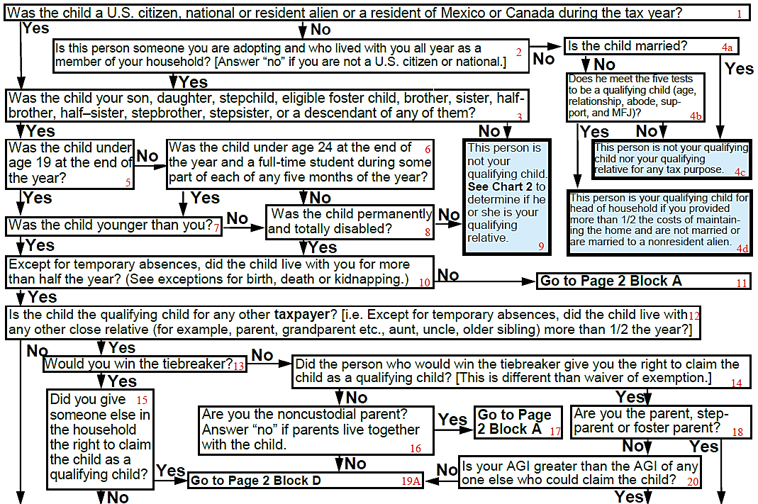
Ex. 5: Lele as QC of Sam
Box 1: Yes, Lele is a US citizen
Box 3: Yes, Lele is Sam’s child
Box 5: Yes, Lele is less than 19
Box 7: Yes, Lele is younger than Sam
Box 10: No, Lele does not live with Sam
Box 11: Go to Block A

Slide 57
Ex. 5: Lele as QC of Sam
Box 32: Yes, Sam is the noncustodial parent
Box 33: Yes, Sam and Mary do not live together
Box 35: No, Mary’s parents pay for more than half of Lele’s support
Box 36: Not Sam’s QC. Go to Chart 2 – before we do that, let’s see if Lele is the qualifying child of any other taxpayer

Slide 58
Ex. 5: Determine Mary’s Status
We need to see if there is a taxpayer that can claim Lele as a qualifying child (which would mean that Sam would not be able to claim Lele as a qualifying relative)
First, we need to know if Mary is a taxpayer.
So we’ll start with Mary as a QC of her parents, then test for Lele as a QC of Mary

Slide 59
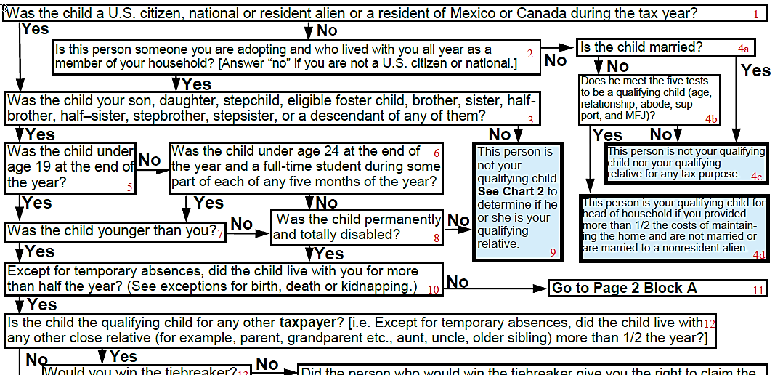
Ex. 5: Mary as Her Parents’ Dependent
Box 1: Yes, Mary is a U.S. citizen
Box 3: Yes, their child
Box 5: Yes, Mary is under 19
Box 7: Yes, Mary is younger than her parents
Box 10: Yes, Mary lives with her parents
Box 12: No, Mary is not be the QC of another taxpayer

Slide 60
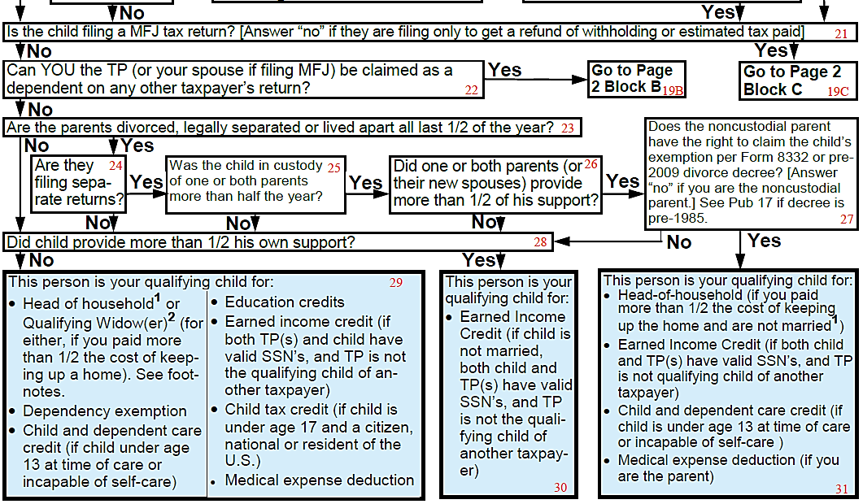
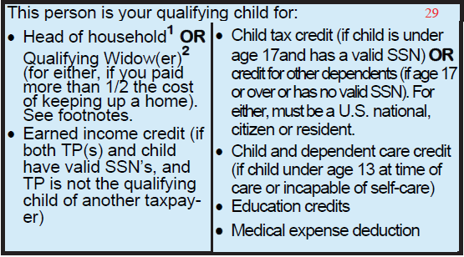
Ex. 5: Mary as Her Parents’ Dependent
Box 21: No, Mary is not filing MFJ
Box 22: No, Mary’s parents cannot be claimed by another taxpayer
Box 23: No, Mary’s parents are not divorced
Box 28: No, Mary did not support herself
Box 29 Blue Box!: Mary is her parents’ QC
Include Mary in Dependents Section of parents’ return

Slide 61
Ex. 5: Is Mary a taxpayer?
A taxpayer is anyone claiming a refundable credit or having a filing requirement.
Is Mary claiming a refundable credit?
No earned income so no EIC
Does Mary have a filing requirement?
As a dependent, her filing threshold is earned income plus $350 up to $12,000 OR unearned income over $1,050
Mary has $2,000 of unearned income
Mary is a taxpayer.

Slide 62
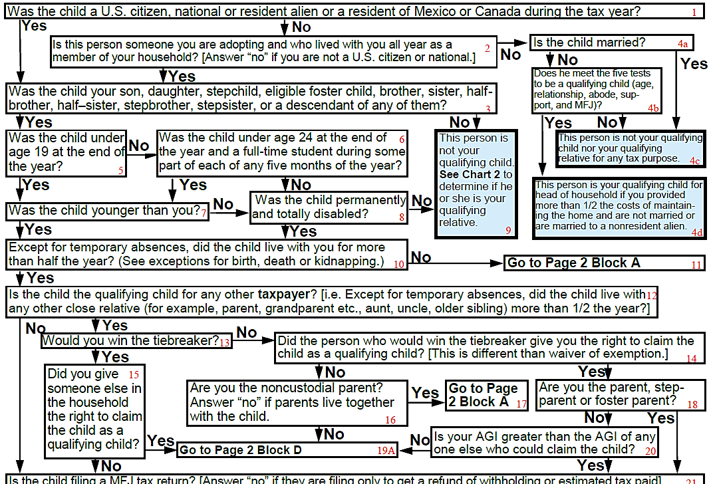
Ex. 5: Lele as a Dependent of Mary
Box 1: Yes, Lele is a US citizen
Box 3: Yes, Lele is Mary’s child
Box 5: Yes, Lele is under 19
Box 7: Yes, Lele is younger than Mary
Box 10: Yes, Lele lives with Mary
Box 12: Lele can be the QC of Mary’s parents, so say yes
Box 13: Yes, Mary would win the tie-breaker
Box 15: Mary is willing to let her parents claim Lele – BUT let’s say NO for now
Notes:
Lele is probably the qualifying child of Mary’s parents

Slide 63
Ex. 4: Lele as a Dependent of Mary
Box 21: No, Lele is not filing a MFJ return
Box 22: Yes, Mary is her parents’ dependent
Box 19B: Go to Block B

Slide 64
Ex. 5: Lele as a Dependent of Mary
Box 47: No, Lele did not provide her own support
Box 48 Blue box!:
HoH — but Mary didn’t pay ½ the cost of the home
Dependent care credit (if Lele is incapable of self-care)
EIC— Mary is a QC so no EIC
Medical expenses—BUT Mary’s tax is small, so this benefit is small
Mary will give her parents the right to claim Lele

Slide 65
Ex. 4: Lele as QC of Mary’s Parents
Box 1: Yes, Lele a US citizen
Box 3: Yes, Lele is their grandchild
Box 5: Yes, Lele is under 19
Box 7: Yes, Lele is younger than the grandparents
Box 10: Yes, Lele lives with the grandparents
Box 12: Yes, Lele is Mary’s QC (if Mary is a taxpayer)
Box 13: No, they would not win the tie-breaker (Mary wins)
Box 14: Yes, Mary gives them the right to claim Lele
Box 18: No, they are the grandparents
Box 20: Yes, their income is more than Mary’s
Notes:
Lele’s mother, Mary, would win the tiebreaker (if she is a taxpayer), but she’s agreed to give her parents any tax benefits that would be hers.

Slide 66
Ex. 5: Lele as QC of Mary’s Parents
Box 21: No, Lele is not filing MFJ
Box 22: No, grandparents cannot claimed by anyone else
Box 23: Yes, Mary and Sam do not live together
Box 24: Yes, Mary and Sam file separately
Box 25: Yes, Mary had custody all year
Bo 26: No, grandparents provided more than ½ of Lele’s support
Box 28: No, Lele did not provide her own support
Box 29 Blue Box!
Include Lele in Dependents Section of grandparents’ return

Slide 67
Ex. 5: Finish Lele as Qualifying Relative of Sam
Box 3: Yes, Lele is the qualifying child of the grandparents
Box 6 Blue Box!: Lele is not Sam’s qualifying relative either
Note: Sam did not meet the support test for children of divorced or separated parents, so fails qualifying child tests
Also, Lele is the qualifying child of another taxpayer (both Mary and grandparents), so Sam did not meet the tests for qualifying relative
Notes:
Comprehensive

Slide 68
Ex. 5: Summary
Lele is not the qualifying child or qualifying relative of Sam
Lele is the qualifying child of her grandparents
They would not win the tie-breaker with Mary
But she agreed that they could claim Lele, and their AGI was higher than Mary’s
Notes:
Comprehensive

Slide 69
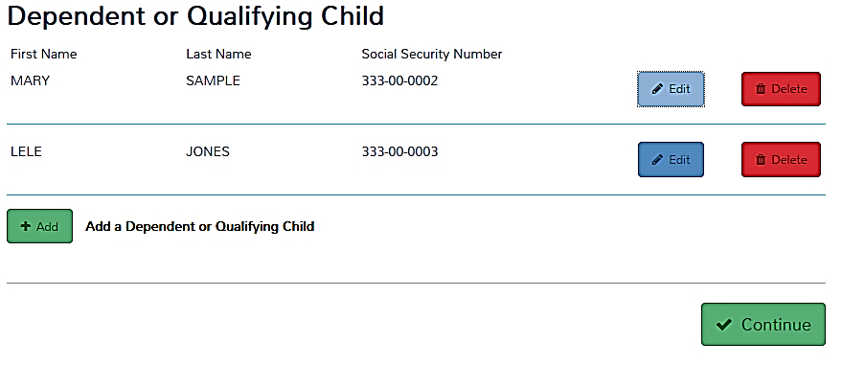
Ex. 5: Dependent Section— Grandparent’s Return

Slide 70
Qualifying Child/Relative Charts

